Slide 1

A Novel Method of Helicopter-Noise Reduction
Ruben Gameros
Mentors: Dr. Valana Wells, Dr. Tom Sharp

Slide 2
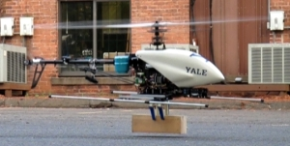
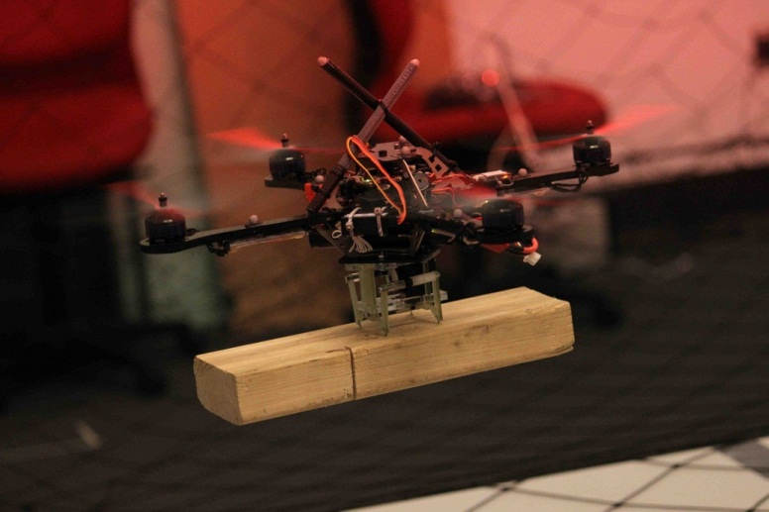
Introduction
Why do we need to reduce the noise?
As helicopters are seen more and more in today’s urban areas noise levels will become an important issue
Technologies that reduce noise can also reduce vibrations transferred to other helicopter components, reducing the need for maintenance
Yale Grab Lab Upenn GRASP Lab

Slide 3
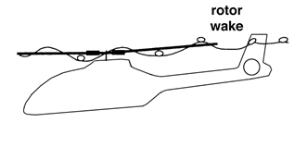

Blade-Vortex Interaction Noise
Interaction between main rotor blades
Interaction between main rotor blades and tail rotors
Currently, most noise-reduction methods focus on this source of noise
Strongest vortices generated at blade tips
Gopalan,2003.

Slide 4
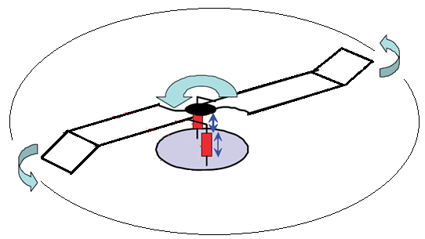
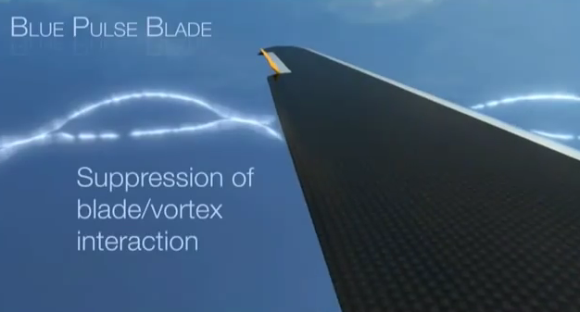
Noise Reduction Method
Flip tip rotors help to remove the blades from the path of the vortices
Canting the outer portions of the blades by ±60 degrees
Eurocopter

Slide 5
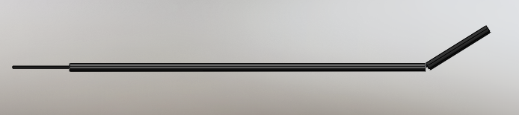
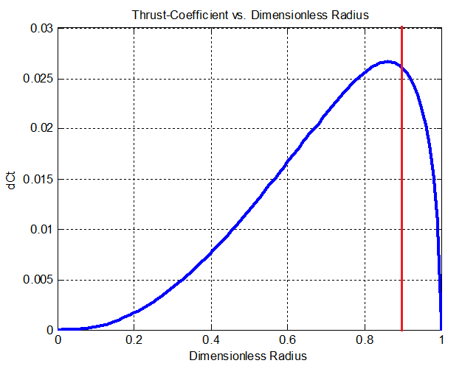

Slide 6
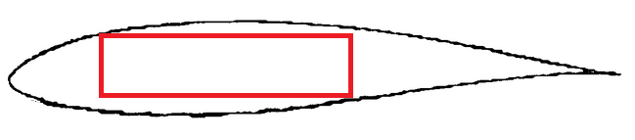
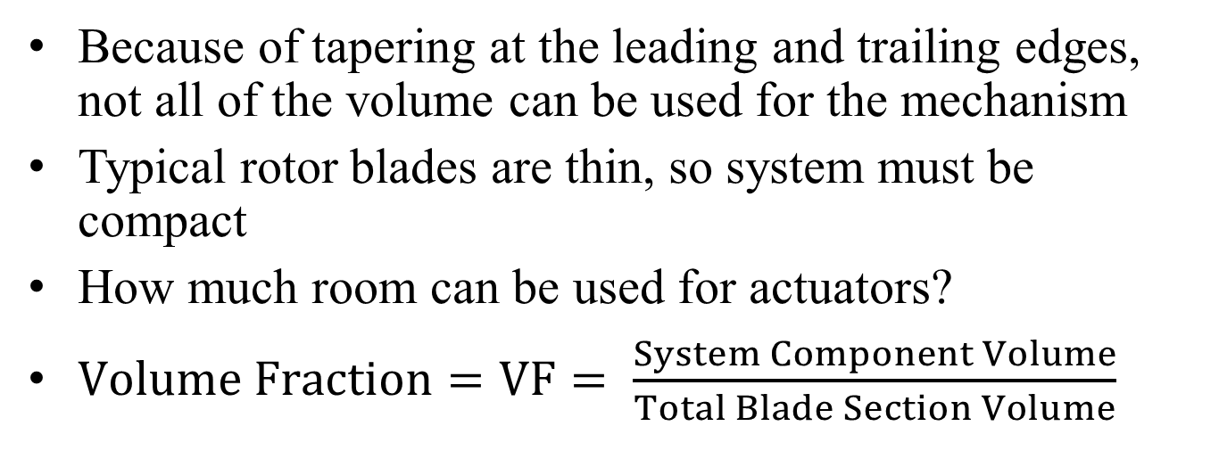
Sizing Constraints
Because of tapering at the leading and trailing edges, not all of the volume can be used for the mechanism
Typical rotor blades are thin, so system must be compact
How much room can be used for actuators?
$Volume Fraction=VF= \frac{System Component Volume}{Total Blade Section Volume}$

Slide 7
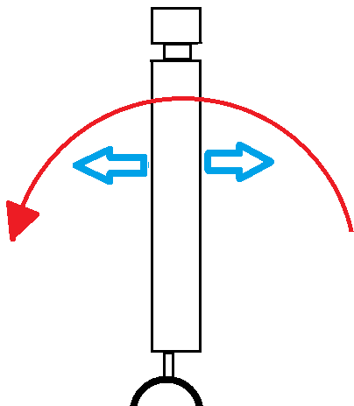
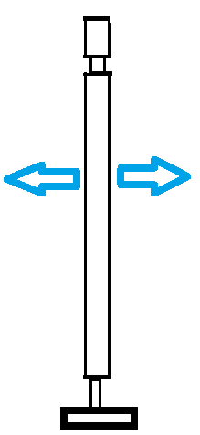
Vibrations
Any actuating mechanism must be vibration-tolerant, as a rotor blade has several sources of excitation:
  Lead/Lag
  Flapping
  High-speed Impulsive effects
Lead/lag motion as seen from above
Side view of a rotor blade: Flapping
Notes:
(mention engine vibrations, but also that they’re not really relevant that far out from the fuselage)

Slide 8
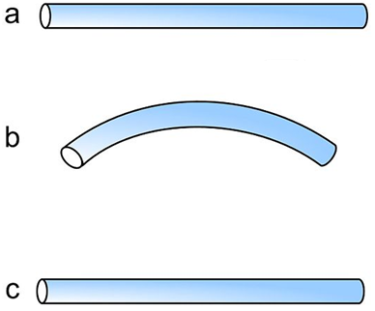
Smart Alloys
Metals that have two properties: super-elasticity and shape-memory
Can “remember” a shape and attempt to return to it when heated to their activation temperature

Slide 9
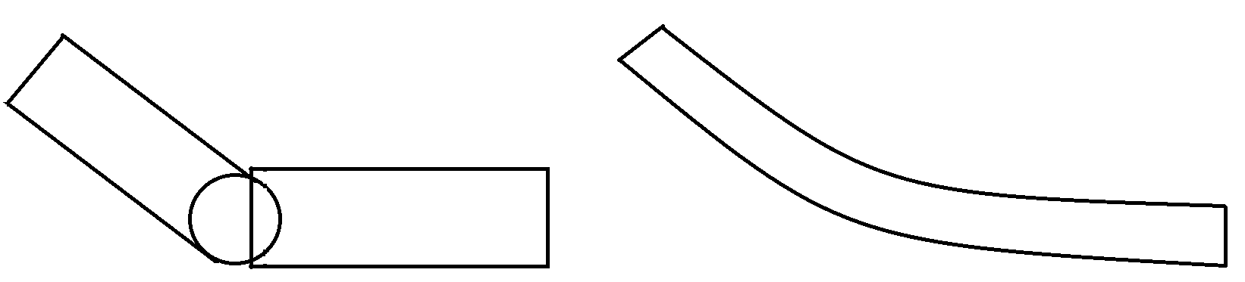
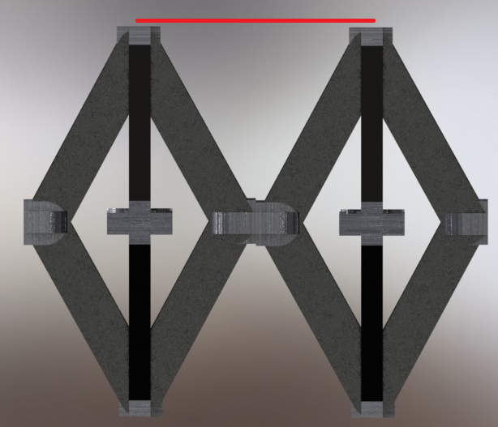
Deformable Truss-Cell
Distributes the amount of actuators throughout the entire volume of the outer portion of the rotor
Easy to achieve multiple configurations
Smoother aerodynamic profile vs. single hinge methods
Requires an advanced skin
Mechanically complex

Slide 10
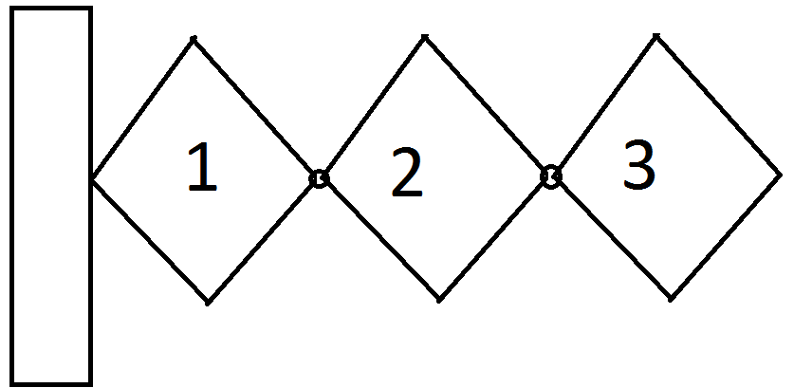
Angle Determination
ɣ/2
ɣ
ɣ
ɵ
The desired ɵ was achieved by find an angle ɣ that would alter each cell’s position so as to reach ɵ.

Slide 11
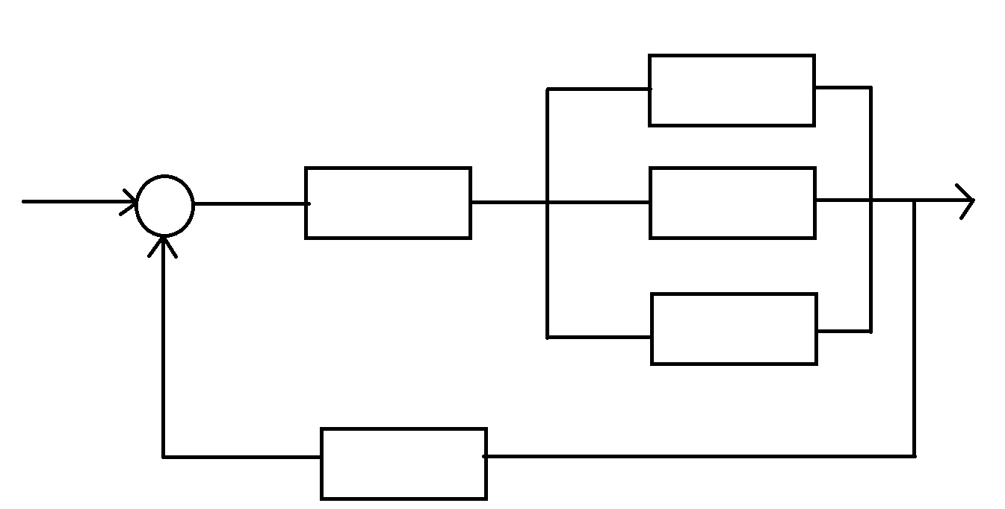
Control Overview
Current Output
Contraction
Desired Deflection
Cell 1
Command with error
Controller
Cell 2
Deflection
Cell 3
Temperature
Sensors

Slide 12
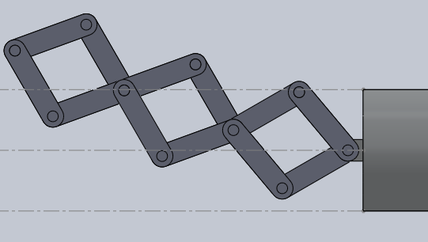
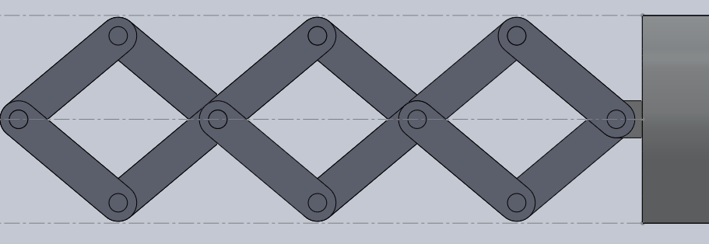
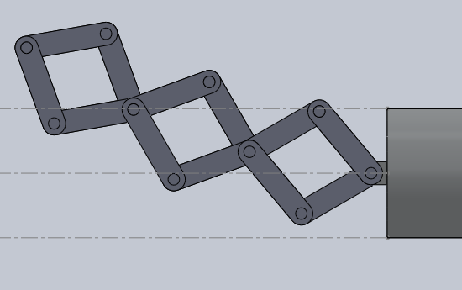
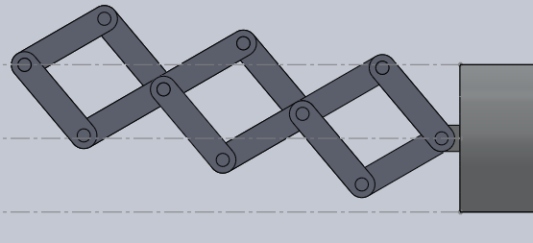
Deformable Truss-Cell
No deformation
10 degrees, 2nd cell
10
10
3
2
1
10 degrees,1st cell
10 degrees, 3rd cell
10
10
10
10

Slide 13
Load estimation
Due to the changing aerodynamic and inertial loads, simplifications were made
Treated as point mass, which will give us an over-estimation of the total moments
For the test case of a 1.5 ft rotor at 2100 RPM
Taken from a blade element analysis of a simple hinged mechanism
Time-dependency of wire-forces ignored
Source of Moment | Moment in ft-lbs
Inertial Loads | 288.1717
Weight | .0001049
Aerodynamic Loads | 1.1250
Loads applied at tip
Notes:
Explain how on the way up inertial loads are max, since on the way up the inertial forces help you
Aerodynamic loads vs. inertial loads
Some equations
Taken from a blade element analysis of a simple hinged mechanism
UH-60 blackhawk type helicopter the engine RPM is about 20900 rpm

Slide 14
Final Design
Mass = 2.6 lbs of structure, 3.656 lbs of nitinol
13 Configurations
Shaft dimensions:
  Diameter = .25 inches
  Length = 7.2 inches
Link dimensions:
  Length = 2 inches
  Square cross section, sides are .2 inches
ɵ (Degrees) | ɣ (Degrees)
10.79 | 5
20.49 | 10
30.20 | 15
38.95 | 20
48.82 | 25
61.96 | 30
Station | Number of Wires Needed | Static Force on Wires (lbs)
From Wall to 1 | 111.6 | 1621
From 1 to 2 | 83 | 909
From 2 to 3 | 45 | 252

Slide 15
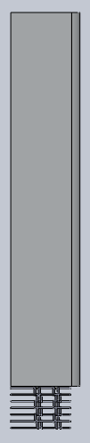
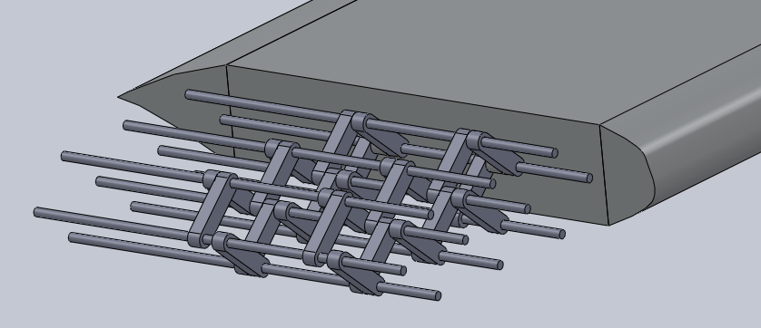
DTC Mechanism
Head-on View
Top View

Slide 16
Questions?

